Slide 1
Using Bayesian Optimization in Pose Graphs Based SLAM 30th June
Zuxun Wang

Slide 2
Progress Since Last Meeting
Generate the Consistency Measurement Metric graph
Omega values from 0.1 -> 1.9, with stride 0.1
Test for both proposition 3 and 4
Calculate the Consistency Measurement Metric for nonlinear system - GPS
Reduce the noise to suppress weird looping
Search for BoTorch tutorial
https://github.com/aoeftiger/TUDa-NMAP-14

Slide 3
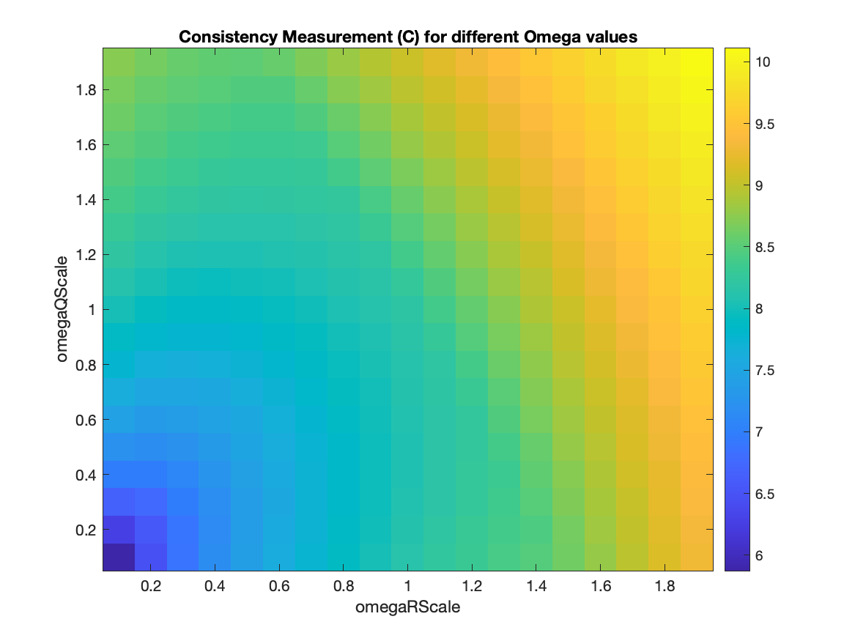
Consistency Measurement Metric (Before Changing Code - Disable proposition 4)

Slide 4
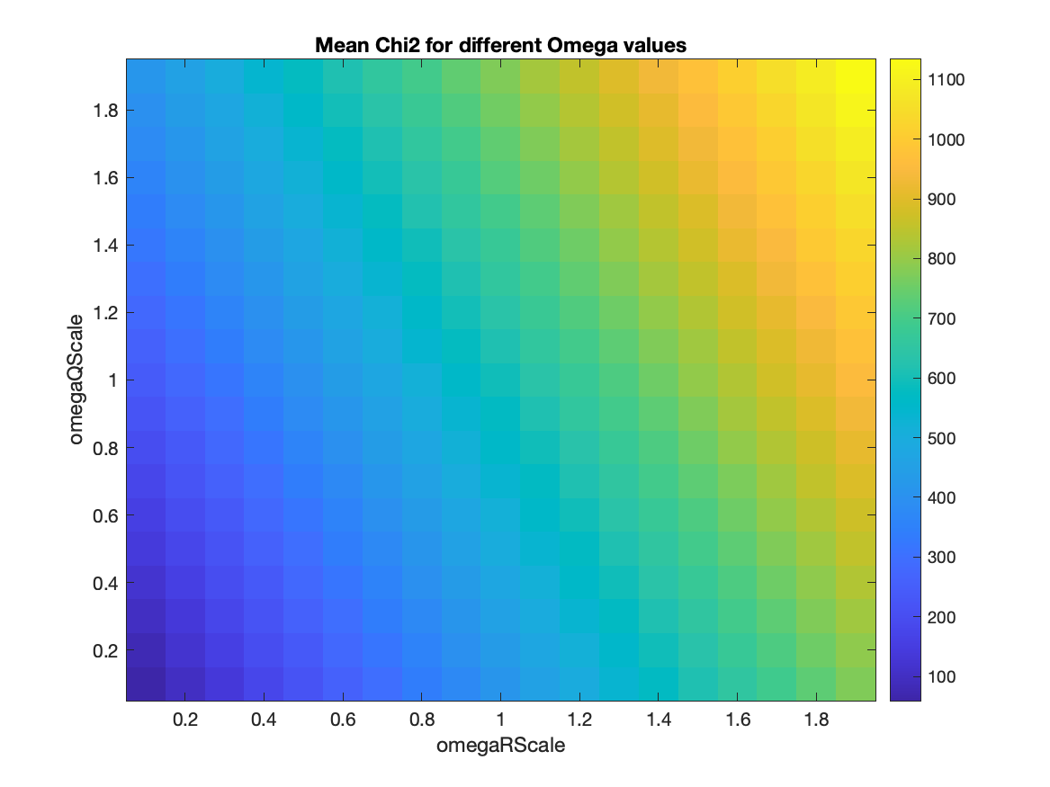
Mean of chi2 (Before Changing Code - Disable proposition 4)

Slide 5
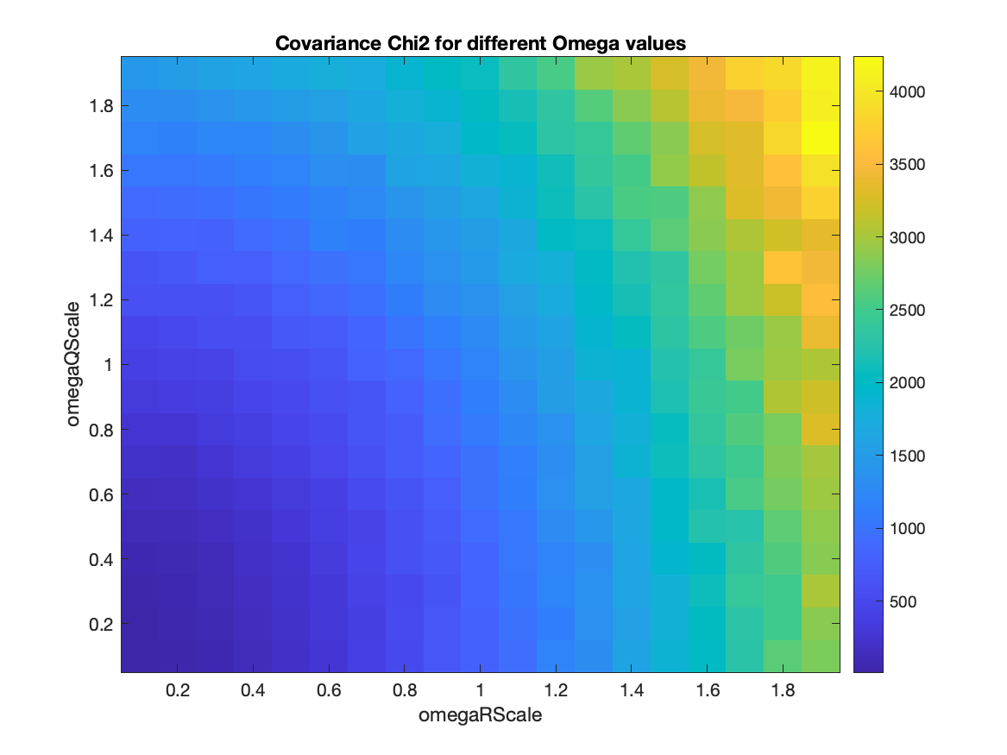
Chi2 covariance (Before Changing Code - Disable proposition 4)

Slide 6
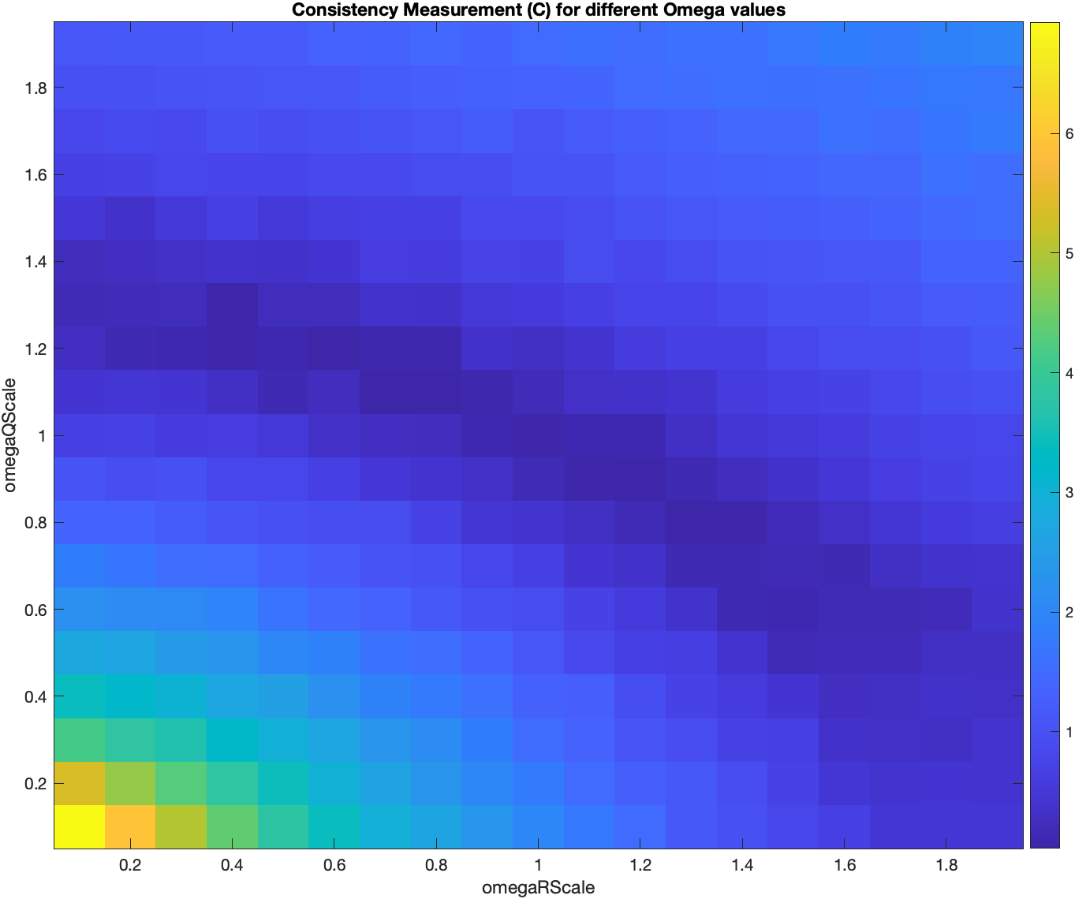
Consistency Measurement Metric (After Changing Code - Disable proposition 4)

Slide 7
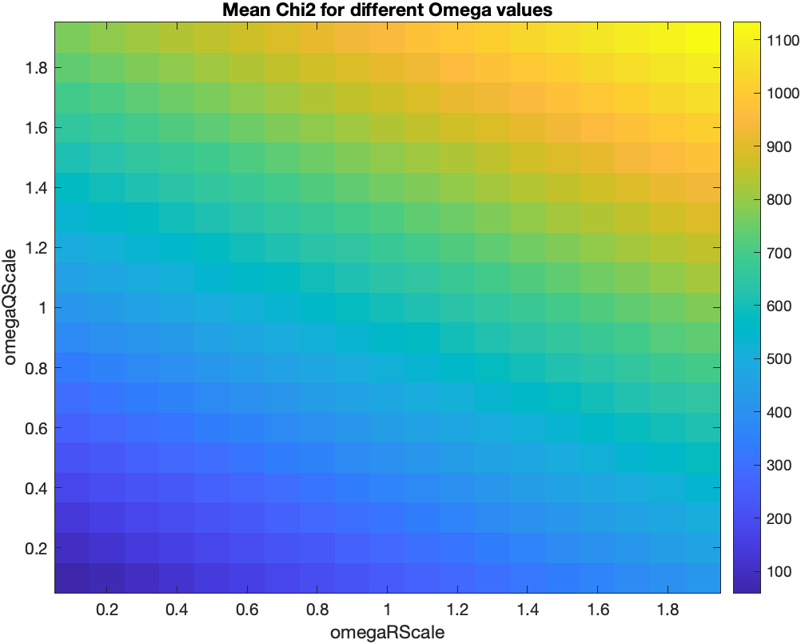
Mean of chi2 (After Changing Code - Disable proposition 4)

Slide 8
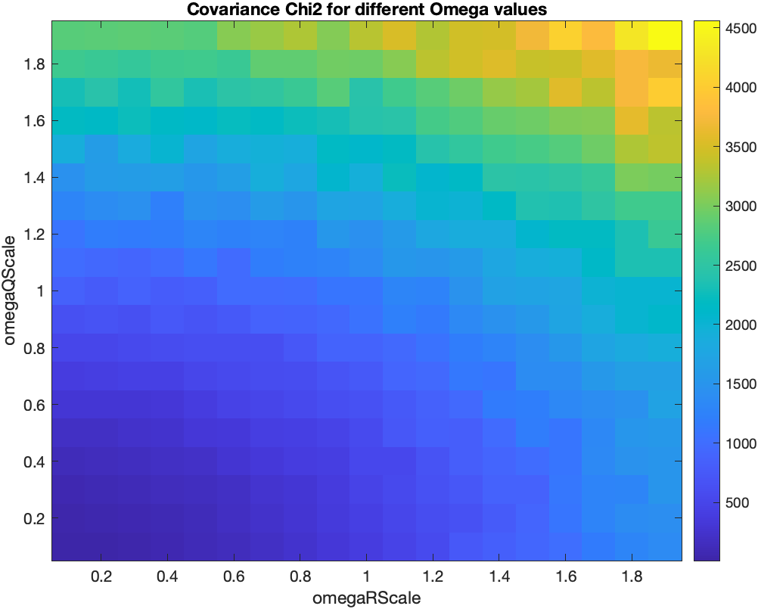
Chi2 covariance (After Changing Code - Disable proposition 4)

Slide 9
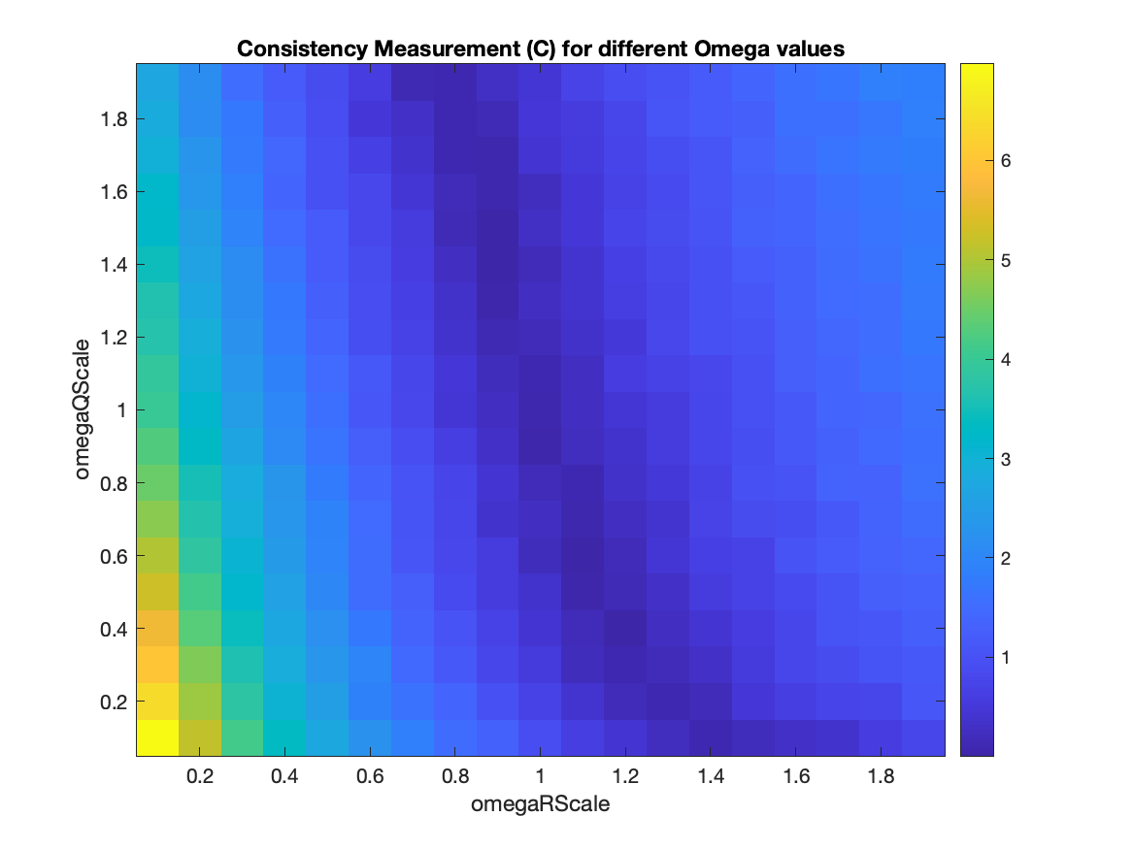
Consistency Measurement Metric (After Changing Code - Enable proposition 4)

Slide 10
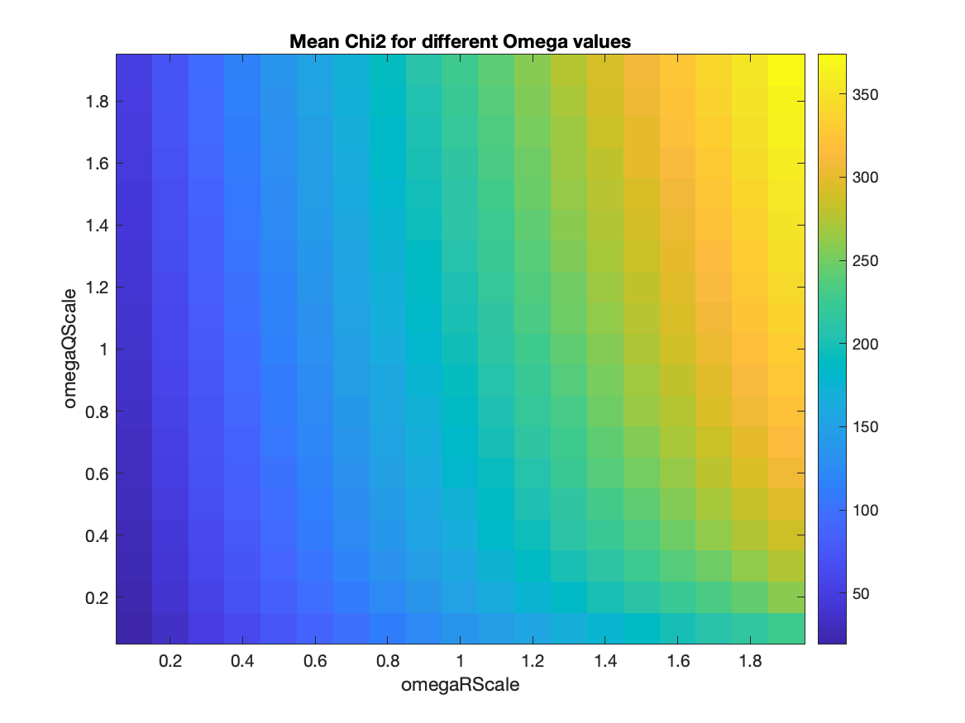
Mean of chi2 (After Changing Code - Enable proposition 4)

Slide 11
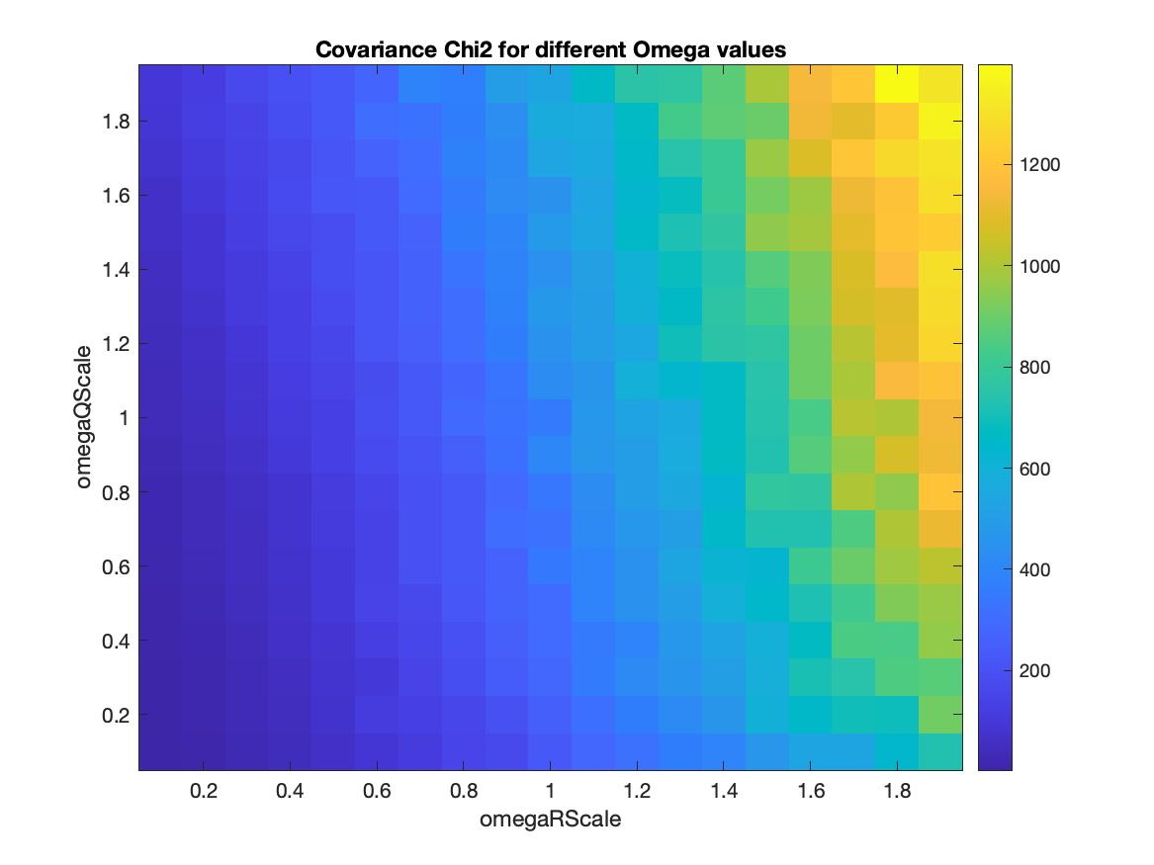
Chi2 covariance (After Changing Code - Enable proposition 4)

Slide 12
Planned Activities
Linear example -> reduce measurement edges
In the first 200 timesteps, for example, have a position observation every time step. Beyond timestep 200, insert a position measurement into the graph every 2 timesteps.
Nonlinear system
Graphs for nonlinear systems
Omega ranges 0.1 to 1.9
VehicleTrackingExample.m

